Slide 1



WebGL Workshop
Carl Bateman
Software Engineer
C#, C++, VB, MySQL, .NET, Linq, blah, blah, blah, blah
Desktop developer – no web
OpenGL
not shaders
JavaScript, PHP, CSS, HTML
Next workshop: Textures and models (probably)
Thursday, February 23rd 2014

Slide 2


WebGL Workshop
Files and slides at
https://webglworkshop.com/03

Slide 3

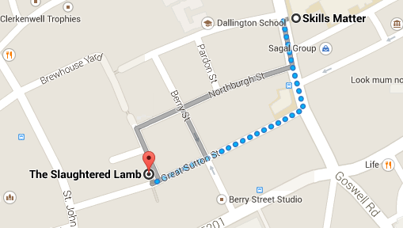
WebGL Workshop
After Workshop Drinkies @ The Slaughtered Lamb

Slide 4
Light and Shadows
Light Types
None
ambient
directional
point
spot

Slide 5
HTML Template - Self-explanatory?
<html> <title> </title> <head>
<style> body {background-color:#b0c4de;} canvas {background-color:#c4deb0;} </style> | Simple styling to differentiate body and canvas
<script id="vertex" type="x-shader"> </script> <script id="fragment" type="x-shader"> </script> | Fragment and vertex shader
<script type="text/javascript"> function init() { } </script> | JavaScript code
</head> <body onload="init()">
<canvas id="glCanvas" width="500" height="500"> | <canvas> element to hold WebGL context
</body> </html>

Slide 6
Hello Triangle 1 - Shaders
<script id="vertex" type="x-shader"> attribute vec2 aVertexPosition; void main() { gl_Position = vec4(aVertexPosition, 0.0, 1.0); } </script> | Vertex position
<script id="fragment" type="x-shader"> precision highp float; uniform vec4 uColor; void main() { gl_FragColor = uColor; } </script> | Fragment (pixel) colour

Slide 7
Hello Triangle 2 – get and clear context
var shaderProgram; var cubeVertexPositionBuffer; | Global variables
function initWebGL() { canvas = document.getElementById(“myCanvas"); | Get glCanvas element
var names = ["webgl", "experimental-webgl", "webkit-3d", "moz-webgl"]; for (var i = 0; i < names.length; ++i) { try { gl = canvas.getContext(names[i]); } catch (e) { } if (gl) break; } | Context name can differ depending on browser Store possible context names in array then try each Can become very complicated Context covers entire canvas
WebGL methods / functions, constants, etc. accessed through context i.e. “gl.” (by convention
gl.viewportWidth = canvas.width; gl.viewportHeight = canvas.height; | Save viewport dimensions

Slide 8
Hello Triangle 3 – build shaders
var v = document.getElementById("vertex"). firstChild.nodeValue; var f = document.getElementById("fragment"). firstChild.nodeValue;
var vs = gl.createShader(gl.VERTEX_SHADER); gl.shaderSource(vs, v); gl.compileShader(vs);
var fs = gl.createShader(gl.FRAGMENT_SHADER); gl.shaderSource(fs, f); gl.compileShader(fs);
program = gl.createProgram(); gl.attachShader(program, vs); gl.attachShader(program, fs); gl.linkProgram(program);

Slide 9
Hello Triangle 4 – check shaders
if (!gl.getShaderParameter(vs, gl.COMPILE_STATUS)) console.log(gl.getShaderInfoLog(vs)); | Check status
if (!gl.getShaderParameter(fs, gl.COMPILE_STATUS)) console.log(gl.getShaderInfoLog(fs));
if (!gl.getProgramParameter(program, gl.LINK_STATUS)) console.log(gl.getProgramInfoLog(program));
gl.useProgram(shaderProgram);
shaderProgram.uColor = gl.getUniformLocation(shaderProgram, "uColor"); gl.uniform4fv(shaderProgram.uColor, [0.0, 1.0, 0.0, 1.0]); | Get position of uniform “uColor”
shaderProgram.aVertexPosition = gl.getAttribLocation(shaderProgram, "aVertexPosition"); | Get position of attribute “aVertexPosition”
gl.enableVertexAttribArray(shaderProgram. aVertexPosition); | Enable vertex array

Slide 10
Hello Triangle 5 – define geometry
function initGeometry() {
var vertices = new Float32Array([-0.5, 0.5, 0.5, -0.5, -0.5, -0.5]); | Define vertices
cubeVertexPositionBuffer = gl.createBuffer(); gl.bindBuffer(gl.ARRAY_BUFFER, cubeVertexPositionBuffer); gl.bufferData(gl.ARRAY_BUFFER, vertices, gl.STATIC_DRAW); | Create buffer and bind data
cubeVertexPositionBuffer.itemSize = 2; cubeVertexPositionBuffer.numItems = vertices.length / cubeVertexPositionBuffer.itemSize; | Itemsize: ordinates in vertex

Slide 11
Hello Triangle 6 – connect to GPU and draw
function draw() { gl.vertexAttribPointer(shaderProgram.aVertexPosition, cubeVertexPositionBuffer.itemSize, gl.FLOAT, false, 0, 0); | Set pointer to vertices
gl.clearColor(0, 0.5, 0, 1); | Clear background to pale blue
gl.clear(gl.COLOR_BUFFER_BIT); | Enable colour clearing
gl.drawArrays(gl.TRIANGLES, 0, cubeVertexPositionBuffer.numItems); | Draw array

Slide 12
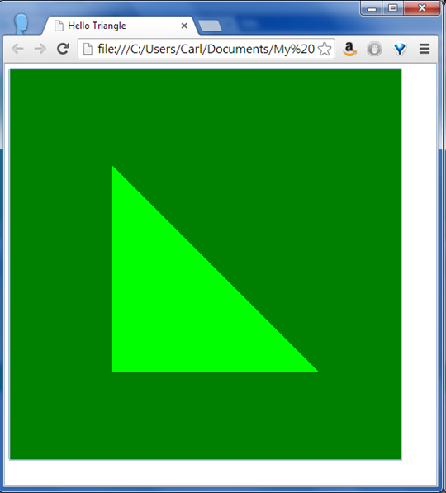
Hello Triangle - result

Slide 13
Steps
Triangle → 3D Square
3D Square → Coloured Cube
Coloured Cube → Rotated Cube
Rotated Cube → Rotatable Cube
Rotatable Cube → Dice

Slide 14
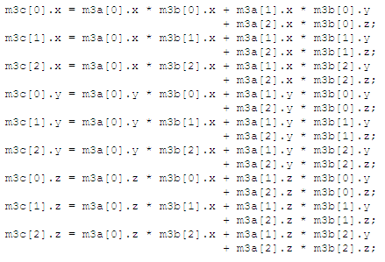
Steps
Triangle → 3D Square
Note: included libraries

Slide 15
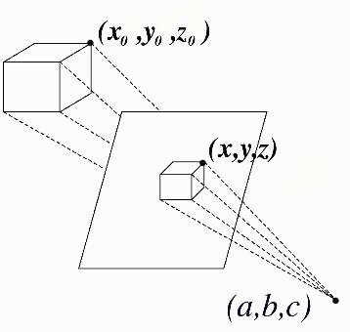
Steps
Triangle → 3D Square
Add perspective projection and model matrices
Change vec2 to vec3
Change assignment to gl_Position

Slide 16
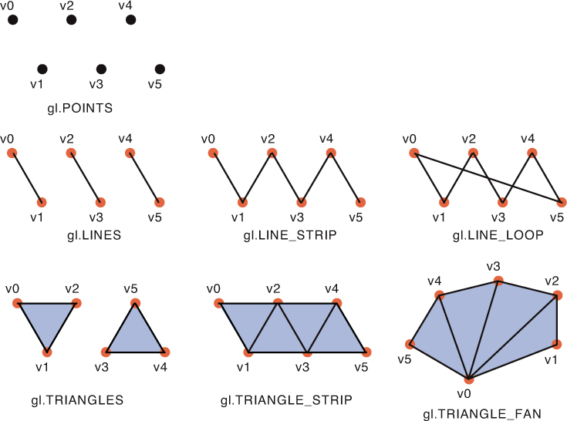
WebGL Primitives

Slide 17
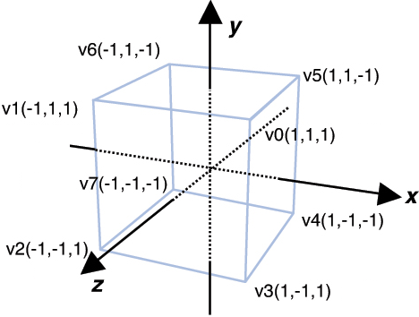
Steps
3D Square → Coloured Cube (1)
Define vertices
Define face colours (and for each vertex)

Slide 18
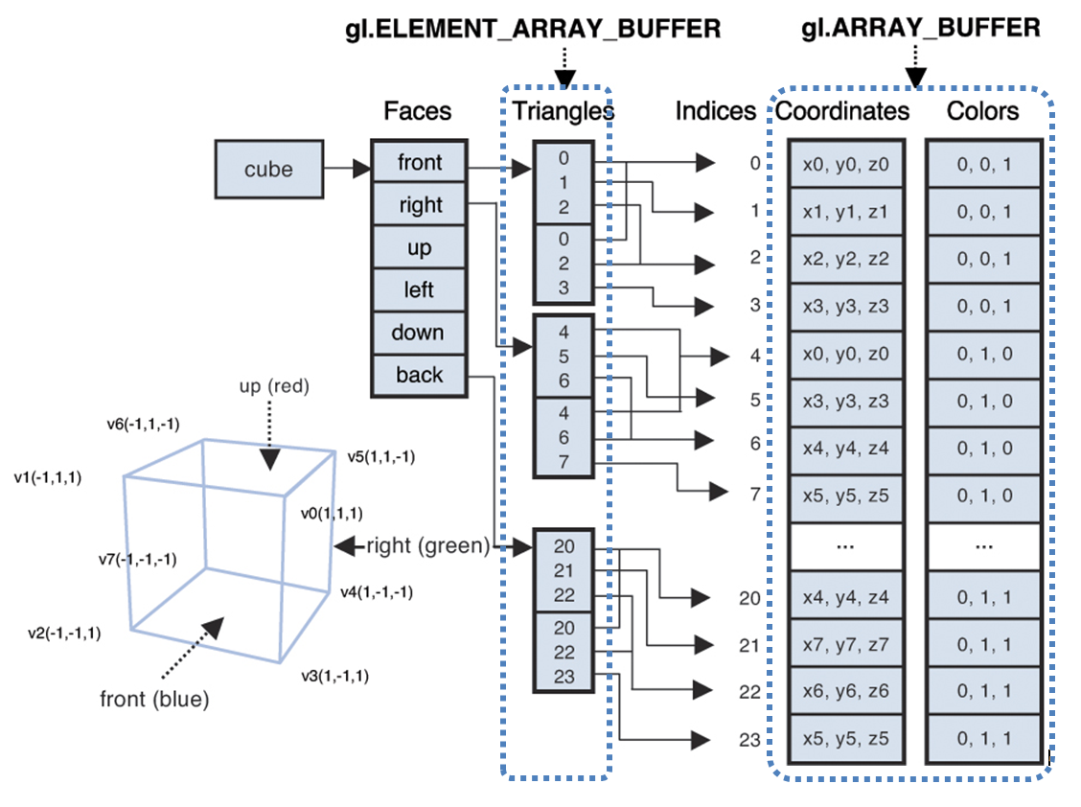
Steps
3D Square → Coloured Cube (2)
Define face colours (and for each vertex)

Slide 19
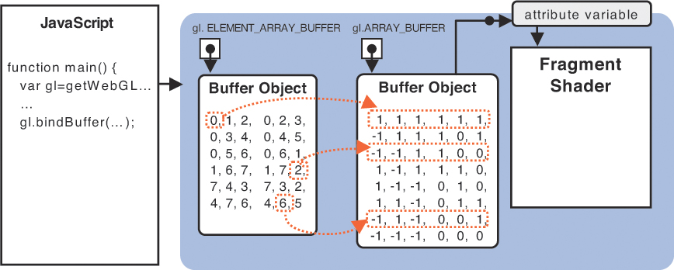
Steps
3D Square → Coloured Cube (3)
Create and bind the buffers and data
Bind buffers and set attribute pointers to draw

Slide 20
Steps
Coloured Cube → Rotated Cube
Add a transformation matrix
Rotation
Position
Scale
Sheer

Slide 21
Steps
Rotated Cube → Rotatable Cube
Add mouse event handlers
Track current and previous mouse position while dragging
Difference => velocity
Update cube orientation
If not dragging reduce velocity

Slide 22
Steps
Rotatable Cube → Dice ???

Slide 23
WebGL Workshop
References:
WebGL Programming Guide
Mozilla Developer Centre
https://developer.mozilla.org/en-US/docs/Web/WebGL
Learning WebGL blog
http://learningwebgl.com/blog/
Get started with WebGL: draw a square http://www.creativebloq.com/javascript/get-started-webgl-draw-square-7112981
Cheat sheets

